Slide 1

Where’s Your Heart?
Notes:
Will Gossett ~ August 23, 2026

Slide 2
One of the most challenging tasks we face is the control over our emotions. It’s easy to get wound up when we see folks driving habits, or the lack thereof, or when someone says something rude to us or even accuses us of something we know nothing about.

Slide 3
In Ephesians 4:26 Paul writes to the church and tells them, “Be angry, and yet do not sin..” Anger is an emotion that we often struggle to control, just like happiness, fear, and disgust.

Slide 4
A lot of our basic emotions can be linked together, or one can be an effect of another, such as fear can escalate to anger like surprise can escalate to happiness. Retrospectively surprise can also turn to disgust, and anger.

Slide 5
Many psychologists believe that our emotions influence our thoughts, decisions, and our relationships. Let us understand, our hearts are the core of our emotions, thus our hearts will influence our thoughts, decisions, and relationships.

Slide 6
Condition of Heart with others

Slide 7
Scripture 1 (version)
Trebuchet MS (Body)
Minimum size = 54
Transition beginning of scripture = Doors
Transition subsequent pages = Page Curl

Slide 8
Scripture 1 (version)
Trebuchet MS (Body)
Minimum size = 54
Transition beginning of scripture = Doors
Transition subsequent pages = Page Curl

Slide 9
Scripture 2 (version)
Trebuchet MS (Body)
Minimum size = 54
Transition beginning of scripture = Doors
Transition subsequent pages = Page Curl

Slide 10
Galatians 6:1-2 (NASB)
¹Brethren, even if anyone is caught in any trespass, you who are spiritual, restore such a one in a spirit of gentleness; each one looking to yourself, so that you too will not be tempted.
² Bear one another’s burdens, and thereby fulfill the law of Christ.

Slide 11
Colossians 4:5-6 (NASB)
⁵ Conduct yourselves with wisdom toward outsiders, making the most of the opportunity.
⁶ Let your speech always be with grace, as though seasoned with salt, so that you will know how you should respond to each person.

Slide 12
James 2:1-4 (NASB)
¹ My brethren, do not hold your faith in our glorious Lord Jesus Christ with an attitude of personal favoritism.

Slide 13
James 2:1-4 (NASB)
² For if a man comes into your assembly with a gold ring and dressed in fine clothes, and there also comes in a poor man in dirty clothes, ³ and you pay special attention to the one who is wearing the fine clothes, and say,

Slide 14
James 2:1-4 (NASB)
“You sit here in a good place,” and you say to the poor man, “You stand over there, or sit down by my footstool,”
⁴ have you not made distinctions among yourselves, and become judges with evil motives?

Slide 15
Galatians 6:9-10 (NASB)
⁹ Let us not lose heart in doing good, for in due time we will reap if we do not grow weary.
¹⁰ So then, while we have opportunity, let us do good to all people, and especially to those who are of the household of the faith.

Slide 16
Condition of Heart with worship

Slide 17
Colossians 3:16-17 (NASB)
¹⁶ Let the word of Christ richly dwell within you, with all wisdom teaching and admonishing one another with psalms and hymns and spiritual songs, singing with thankfulness in your hearts to God.

Slide 18
Colossians 3:16-17 (NASB)
¹⁷ Whatever you do in word or deed, do all in the name of the Lord Jesus, giving thanks through Him to God the Father.

Slide 19
James 5:15-16 (NASB)
¹⁵ and the prayer offered in faith will restore the one who is sick, and the Lord will raise him up, and if he has committed sins, they will be forgiven him.

Slide 20
James 5:15-16 (NASB)
¹⁶ Therefore, confess your sins to one another, and pray for one another so that you may be healed. The effective prayer of a righteous man can accomplish much.

Slide 21
I Corinthians 11:26-29 (NASB)
²⁶ For as often as you eat this bread and drink the cup, you proclaim the Lord’s death until He comes. ²⁷ Therefore whoever eats the bread or drinks the cup of the Lord in an unworthy manner, shall be guilty of the body and the blood of the Lord.

Slide 22
I Corinthians 11:26-29 (NASB)
²⁸ But a man must examine himself, and in so doing he is to eat of the bread and drink of the cup.
²⁹ For he who eats and drinks, eats and drinks judgment to himself if he does not judge the body rightly.

Slide 23
II Corinthians 9: 6-7 (NASB)
⁶ Now this I say, he who sows sparingly will also reap sparingly, and he who sows bountifully will also reap bountifully.
⁷ Each one must do just as he has purposed in his heart, not grudgingly or under compulsion, for God loves a cheerful giver.

Slide 24
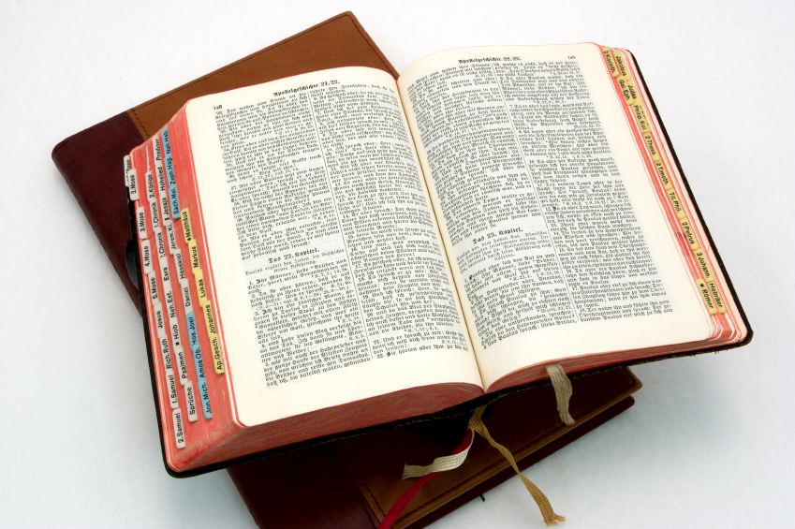
Hear: Romans 10:17 (NASB)
So faith comes from hearing, and hearing by the word of Christ.

Slide 25
Believe: Hebrews 11:6
But without faith it is impossible to please him: for he that cometh to God must believe that he is, and that he is a rewarder of them that diligently seek him.

Slide 26
Repent: Luke 13:3
I tell you, Nay: but, except ye repent, ye shall all likewise perish.

Slide 27
Confess: Matthew 10:32-33
32 Whosoever therefore shall confess me before men, him will I confess also before my Father which is in heaven.
33 But whosoever shall deny me before men, him will I also deny before my Father which is in heaven.

Slide 28
Baptize: Acts 22:16
And now why tarriest thou? arise, and be baptized, and wash away thy sins, calling on the name of the Lord.

